Slide 1
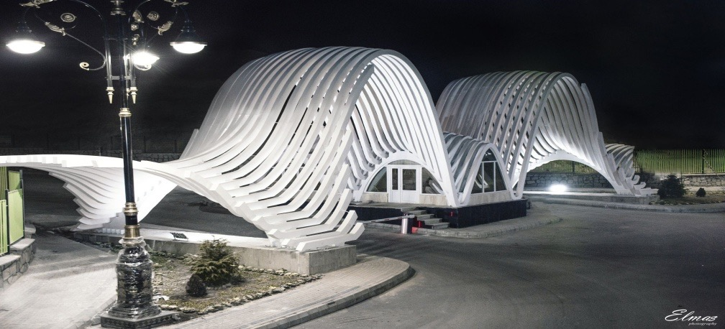
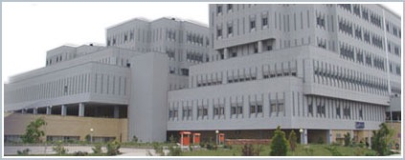
Micturition Phase NLUTD
Sakineh Hajebrahimi, MD
Professor of Urology &Neurourology Department, Research center for EBM, TUMS, Tabriz, Iran

Slide 2
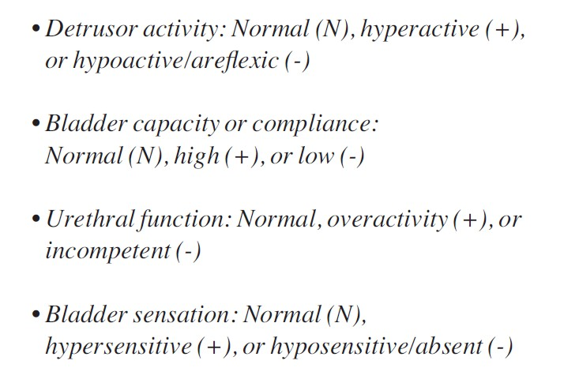
Classification
Functional (Bladder and Outlet)
Storage
Emptying
ICS Classification

Slide 3
Storage
Ability to inhibit spontaneous contractions
Sensation of fullness
Adequate sphincter competence at rest and with activity
Expulsion
Facilitated bladder contraction
Relax sphincters – BN and EUS
Void to completion
Competent U-V Junction
Bladder
Bladder Neck
“Internal Sphincter”
Striated Muscle
“External sphincter”

Slide 5
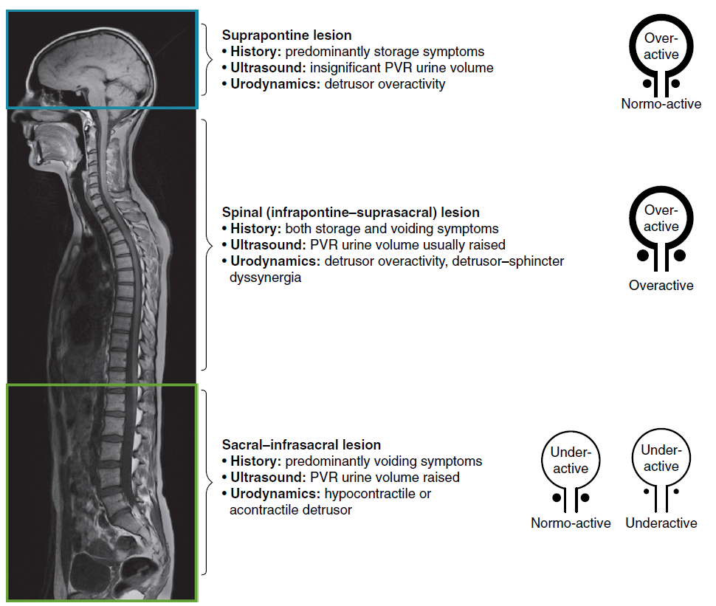
Patterns of Lower Urinary Tract Dysfunction Following Neurological Disease
Panicker, J.N., Fowler, C.J., Kessler, T.M., 2015. Lower urinary tract dysfunction in the neurological patient: clinical assessment and management. Lancet Neurol 14[7], 720–732

Slide 6
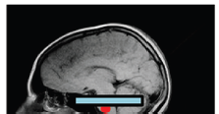
Suprapontine lesion
• History: predominantly storage symptoms
• Ultrasound: insignificant PVR urine volume
• Urodynamics: detrusor overactivity
Suprapontine lesions affect the ability of the bladder to store urine because of reduced bladder wall compliance and spontaneous involuntary contractions of the detrusor, termed detrusor overactivity.
Urinary incontinence following neurologic disease is most commonly due to detrusor overactivity.
Overactive
Normoactive
Panicker, J.N., Fowler, C.J., Kessler, T.M., 2015. Lower urinary tract dysfunction in the neurological patient: clinical assessment and management. Lancet Neurol 14[7], 720–732

Slide 7
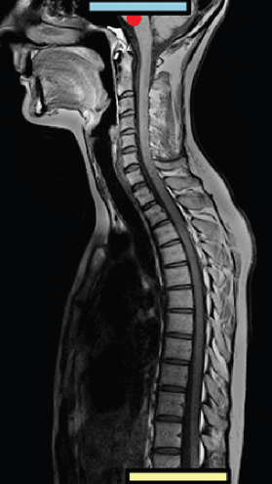
Spinal (infrapontine–suprasacral) lesion
• History: both storage and voiding symptoms
• Ultrasound: PVR urine volume usually raised
• Urodynamics: detrusor overactivity, detrusor–sphincter dyssynergia
Injury to the Suprasacral pathways in the spinal cord also results in storage dysfunction.
Additionally, the normally coordinated activity between the detrusor and urethral sphincters during voiding becomes impaired, and the detrusor and urethral sphincters contract simultaneously, a condition termed Detrusor Sphincter Dyssynergia.
Voiding dysfunction results in incomplete
emptying of the bladder and urinary retention.
Overactive
Overactive
Panicker, J.N., Fowler, C.J., Kessler, T.M., 2015. Lower urinary tract dysfunction in the neurological patient: clinical assessment and management. Lancet Neurol 14[7], 720–732
Notes:
automatic reftex bladder

Slide 8
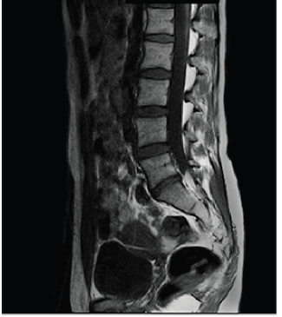
Sacral–infrasacral lesion
• History: predominantly voiding symptoms
• Ultrasound: PVR urine volume raised
• Urodynamics: hypocontractile oracontractile detrusor
Underactive
Injury to the conus medullaris, sacral roots of the cauda equina, or peripheral nerves
- Sacral–infrasacral lesions – results primarily in voiding dysfunction from poorly sustained detrusor contractions or a nonrelaxing sphincter, or both.
Normoactive
Underactive
Underactive
Panicker, J.N., Fowler, C.J., Kessler, T.M., 2015. Lower urinary tract dysfunction in the neurological patient: clinical assessment and management. Lancet Neurol 14[7], 720–732
Notes:
autonomous bladder

Slide 11
Traumatic Spinal Cord Injury
Lower urinary tract function varies depending on stage of
recovery from SCI
Phases of recovery
Spinal Shock: Detrusor areflexia, flaccid paralysis, reflexes absent below the level of the lesion
Recovery: Return of reflux detrusor activity
Stable pattern is general finding long-term

Slide 12
Evaluation and diagnosis
Important to:
Safety of patient
🞄 Protect Upper Tracts
🞄 Prevent UTI
🞄 Prevent stone formation
Social Well Being
🞄 Achieving continence
🞄 Optimizing QOL

Slide 13
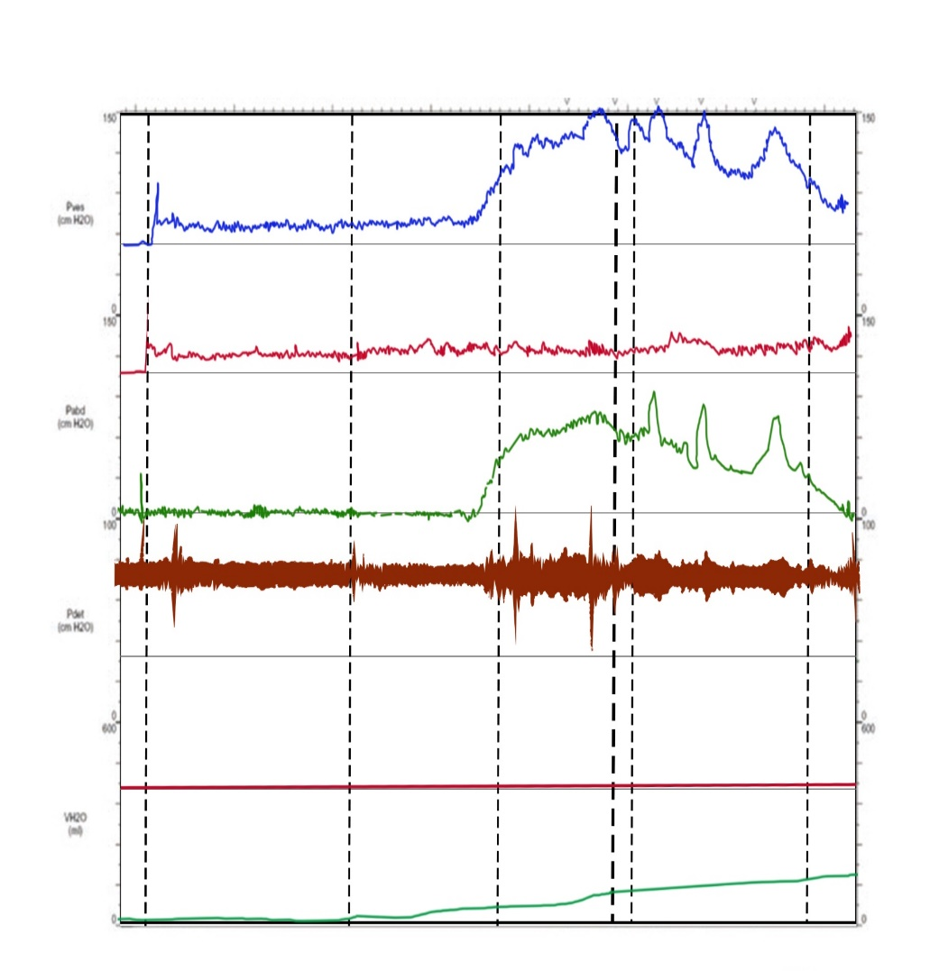
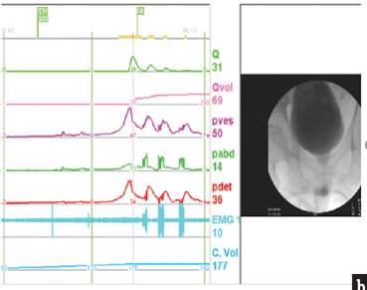
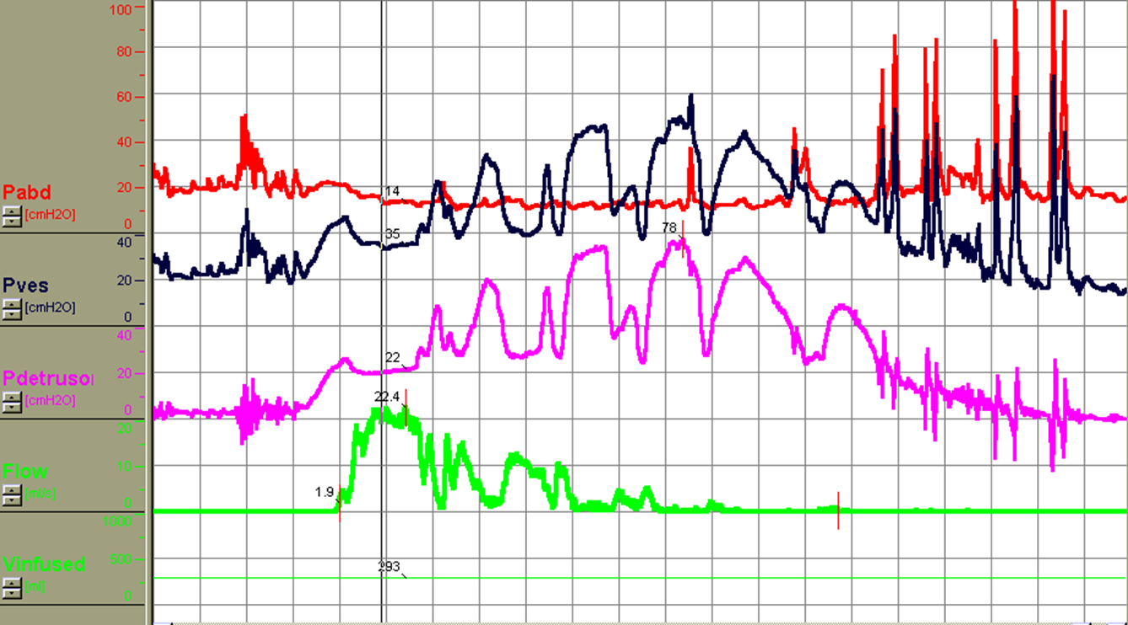
Detrusor overactivity and DSD
In DSD, when there is flow, detrusor pressure drops

Slide 14
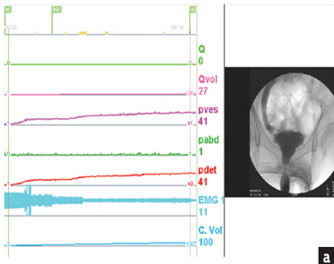
Low capacity and low compliance bladder with VUR

Slide 15
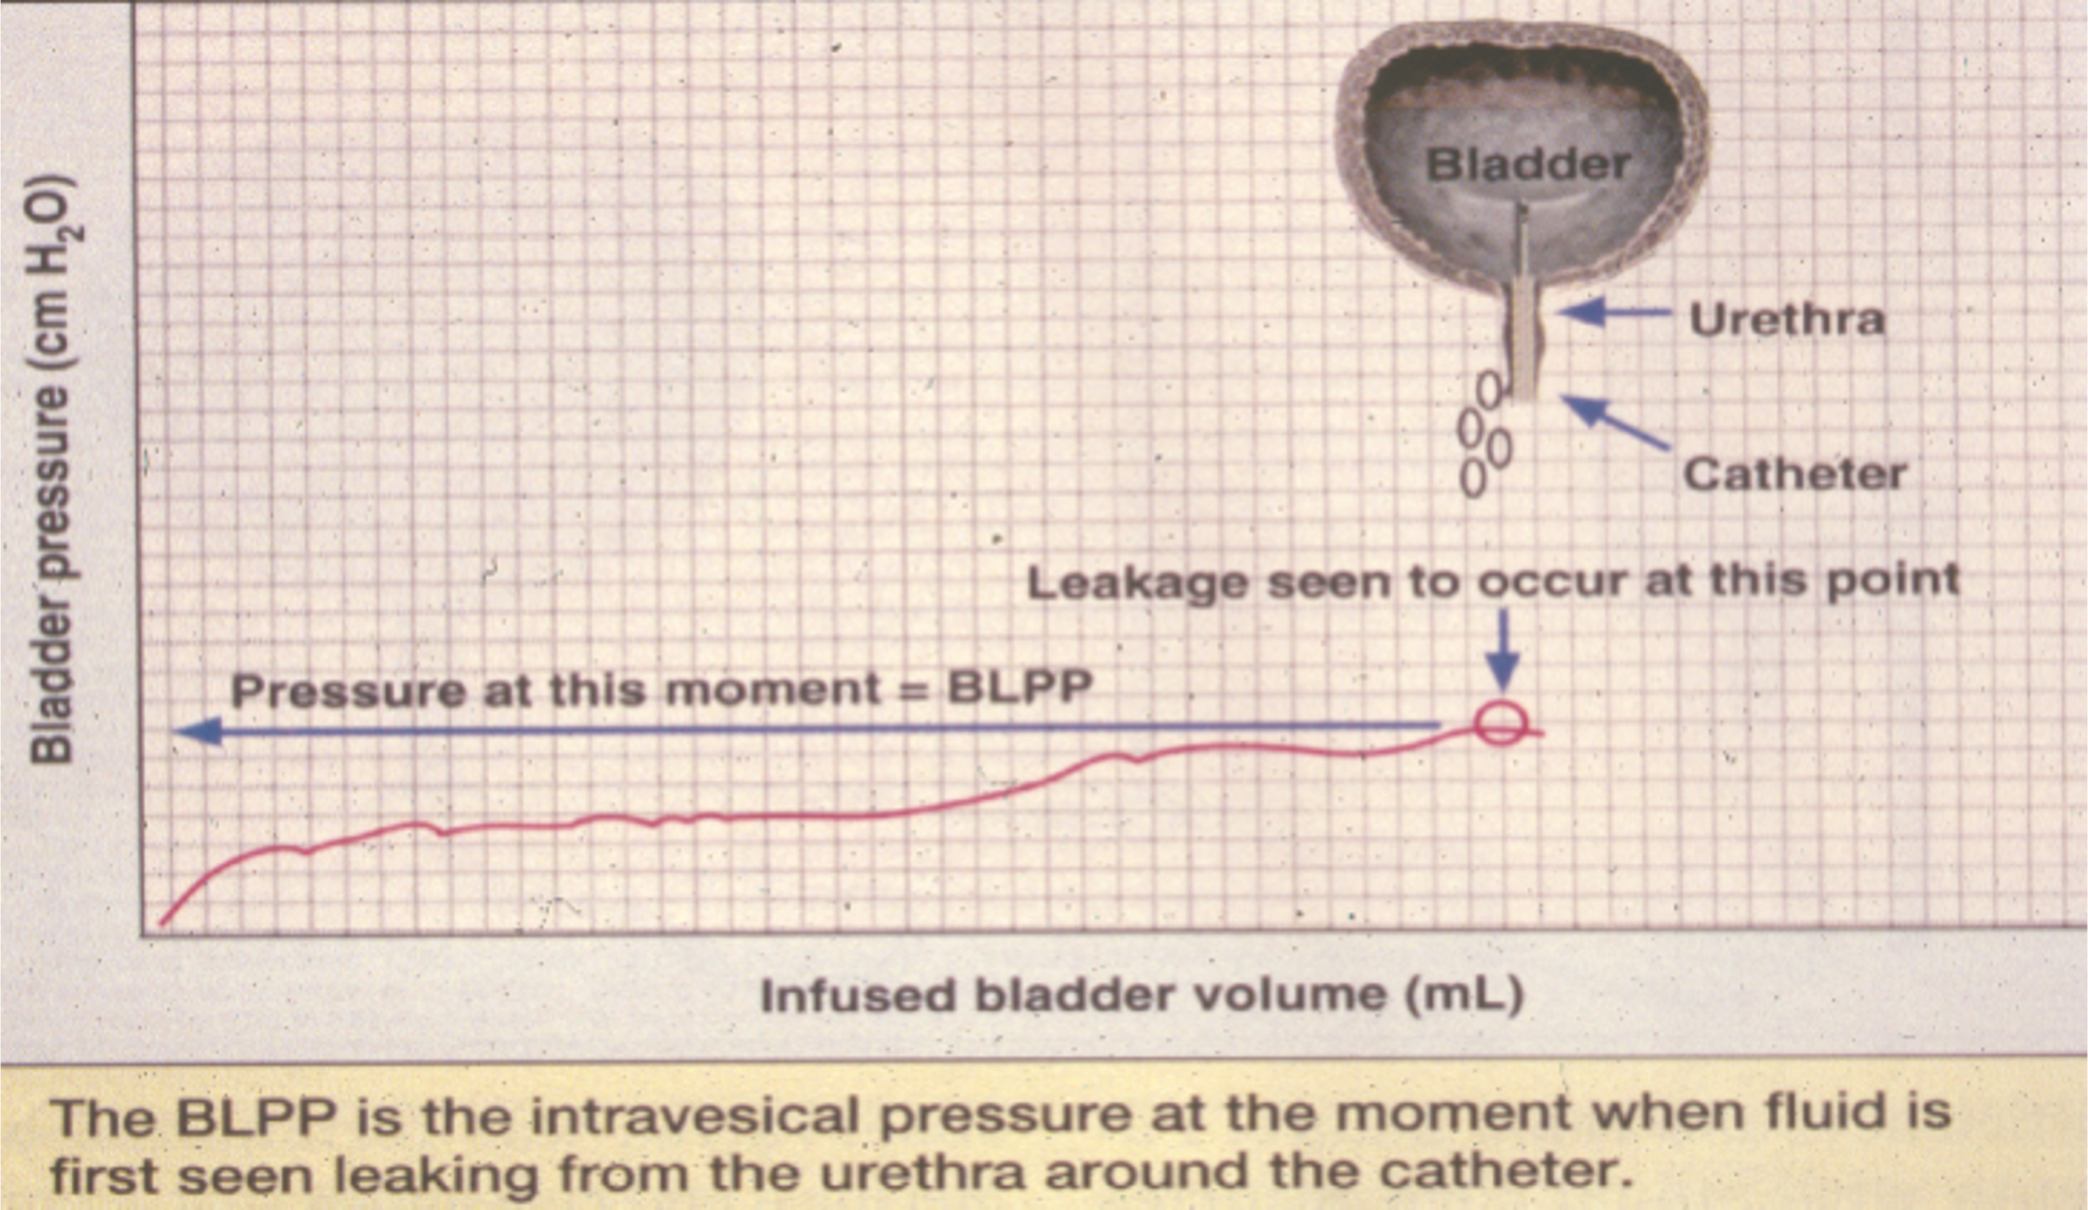
.

Slide 16
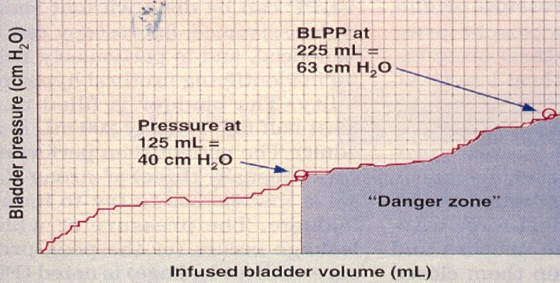
High Detrusor Leak Point Pressure
Anton HA, CMAJ, 2004

Slide 17
Detrusor overactivity and DSD
In DSD, when there is flow, detrusor pressure drops

Slide 18
Straining vs DSD?
PAbd
PVes
PDet
Q Flow
EMG

Slide 21
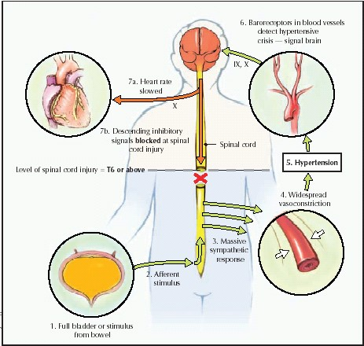
Autonomic Dysreflexia
Anton HA, CMAJ, 2004; Danforth and Ginsberg Urol Clin North Am 41(3) 445-52, 2014

Slide 22
Autonomic dysreflexia
SCI patients with injury above T6.
Autonomous distal cord gives a mass sympathetic nervous system response
Vasoconstriction below the injury level
Vasodilatation above; bradycardia, headache, anxiety, flushing, sweating.
Triggered by a noxious stimulus below SCI level; often distended bladder or bowel

Slide 23
Autonomic dysreflexia
Prevention with appropriate anaesthesia
Hypertension can be life-threatening
Initial treatment is to relieve the cause (empty bladder)
Institute head-up position.
Vasodilator, calcium antagonist or beta blocker
Prevent further attacks

Slide 24
Management
Failure to Store
Bladder (Detrusor Overactivity, Poor Compliance)
Behavioral Treatment
Fluid management
Dietary management
Constipation management
Medication adjustment (diuretics)
Bladder retraining
Identification and treatment of functional incontinence
Bedside commodes
Urinals
Proper use of absorbent products
🞄 Perineal skin care and hygiene

Slide 25
Management
Pharmacological interventions:
Antimuscarinics and B-adrenergics, Tricyclic antidepressants, DDAVP
Botulinum Toxin Injection
Sacral Neuromodulation/PTNS
Enlargement cystoplasty
Incontinent urinary diversion
Ileovesicostomy
Urinary conduit
Continent urinary diversion

Slide 26
Management
Outlet (DESD, BPH, incomplete urethral relaxation)
CIC
Pharmacological interventions: Alpha antagonists, Muscle relaxants
Botulinum Toxin Injection
External sphincterotomy +/- bladder neck incision, TURP
UroLume® stent
Indwelling urethral catheter or suprapubic tube

Slide 27
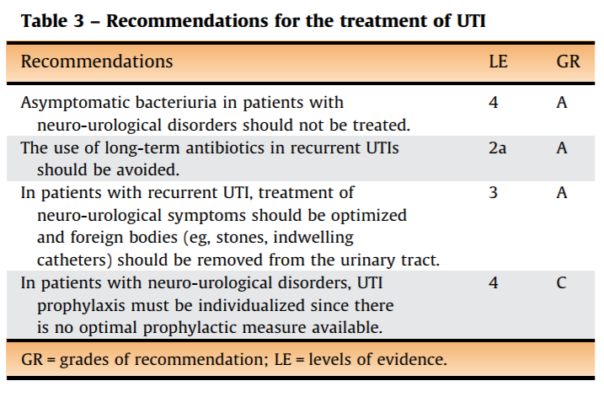
UTI

Slide 29
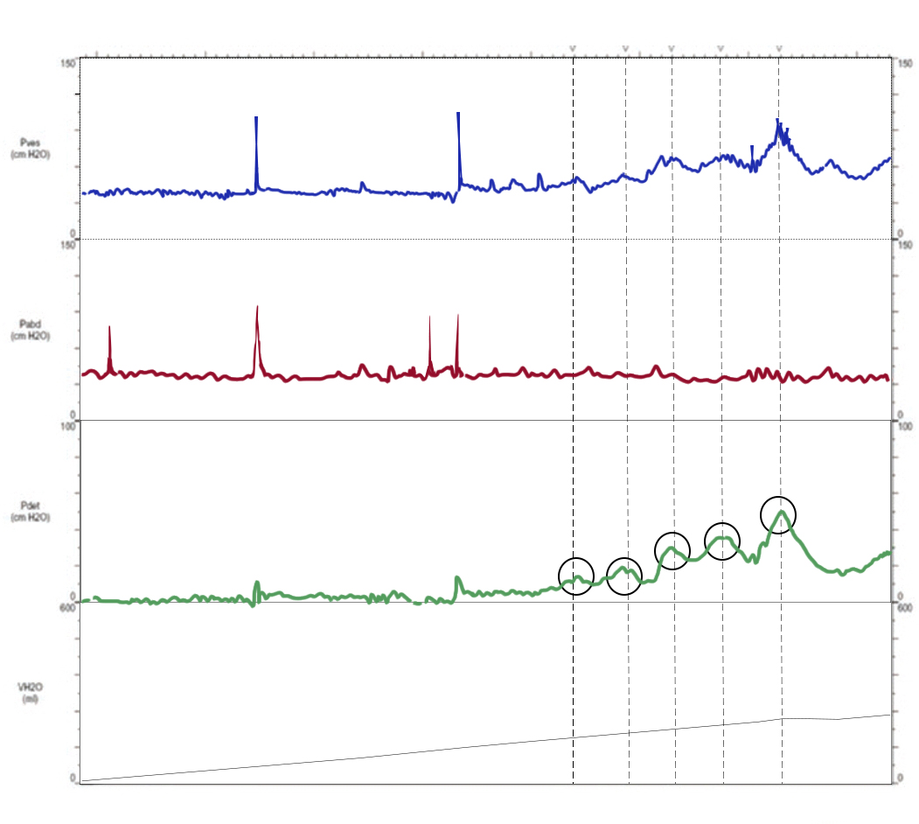
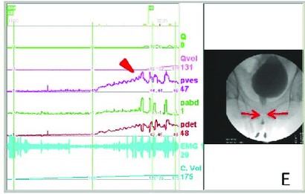
PD

Slide 31
Neurodegenerative disorder affecting
The dopaminergic neurons of the substantia nigra
MSA not only neurons but also glia involved
Voiding dysfunction in 45%
Bradykinesia may be present with NDO but not true dyssynergia
MSA mimics early Parkinson’s Disease but more rapidly
progressive
characterized by NDU, open bladder neck and denervated sphincter—beware of TURP in these patients

Slide 32
Urodynamic traces a. The pressure flow trace of a male patient with Parkinson’s disease showed the continuous drop of detrusor pressure after urine flow began and a low flow rate; b. The pressure flow trace of a male patient with Parkinson’s disease showed similar features. EMG showed the delayed sphincter relaxation; c. The pressure flow trace of an age-matched male patient with benign prostatic obstruction showed detrusor pressure exhibited a “plateau period”. Pves: vesical pressure; Pabd: abdominal pressure; Pdet: detrusor pressure; EMG: electromyography

Slide 34
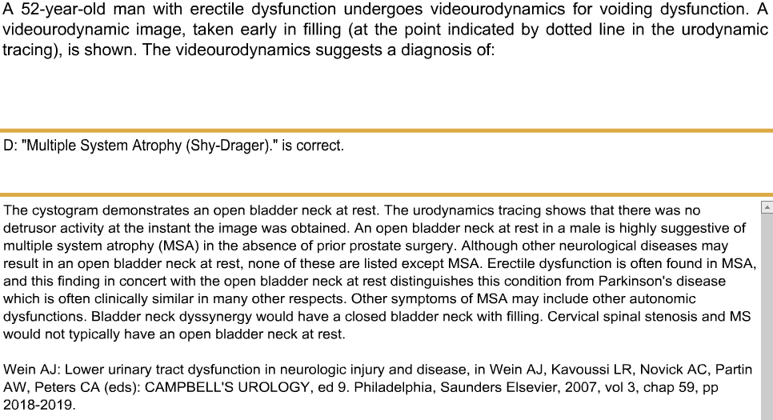

Slide 35
A 59 years old diabetic housewife lady G:3 P:3
Urgency, frequency, Failure to emptying, low flow urination , Nocturia , constipation. She has a history of TAH 18 month a go.
BMI<28
No smoking
Vaginal Exam : Mild cystocele and rectocele and no urethral hypermobility
ICIQ-UI SF Score:5
Recurrent UTI
Voiding Diary :no polyuria
Ultrasound: No hydronephrosis with PVR:75cc
BUN:28, Cr:1.1
Normal cystoscopy
Conservative management including antimuscrinics Failed
3rd EAU-IUA Educational Meeting, 2016, Kish Island

Slide 37
Coexisting DO,DU
Known as detrusor hyperactivity with impaired contractility (DHIC)

Slide 38
DU
This is based mainly on
detrusor pressure at the maximum urinary flow rate (Pdet@Qmax) :
degree of emptying values of >40 cmH2O are normal, 30–40 cmH2O are mild DU, 20–30 cmH2O are moderate DU, and <20 cmH2O are severe DU

Slide 39
Management
Failure to Empty
Bladder (Detrusor Underactivity, Hypocontractility)
Constipation management, Medication adjustment
(diuretics, sedatives, etc.)
Prompted/timed bladder emptying (voided or
catheterized) or crede void
CIC

Slide 40
Management
Medical????????
Surgical:
Botulinum toxin
SNM
Indwelling urethral catheter or suprapubic tube

Slide 41
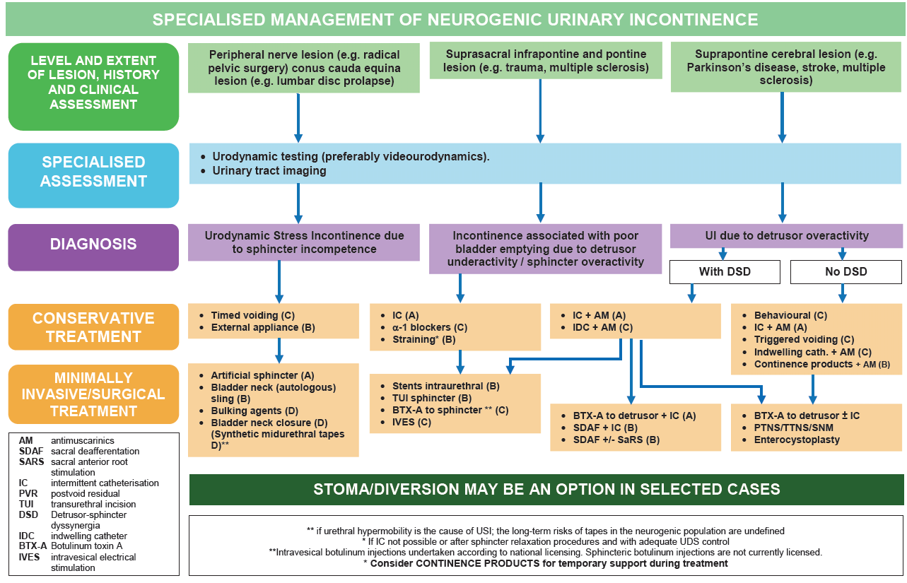
Conclusion

Slide 42
Key Points
Neurogenic Bladder is dysfunction of bladder resulting from disease of CNS or peripheral nerves that control micturition, Bowel and Sexual function : A team work
Urodynamics key to diagnostic tool.
Goals of Treatment: 1. preserve renal function, 2. reduce complications such as urinary incontinence, UTI’s, renal/bladder stones; 3. providing an acceptable and realistic means for urinary drainage

